Slide 1

‘The Journey from Research Evidence to Policy Impact’
Presented by
Dr Elizabeth Morrow, Royal College of Surgeons in Ireland
professionalpalliativehub.com/research/

Slide 2



11.00-12.00
Dr Elizabeth Morrow
Senior Research Fellow, Faculty of Nursing & Midwifery,
RCSI University of Medicine and Health Sciences
AIIHPC Palliative Care Research Network Member

Slide 3

Acknowledgements
AIIHPC
Karen Charnley, Chief Executive Officer, AIIHPC; Melanie Nugent, Programme Manager for Education and Practice, AIIHPC; Dr Mary Rabbitte, Research Programme Manager; Jane Clare, PCRN Project Manager; Dr Busra Ertugrul, Research Support and Knowledge Translation Lead.
Martina O’Reilly, HSE National Clinical Programme for Palliative Care; Lisa McGirr, St Francis Hospice Dublin; Niamh Donnelly, St Francis Hospice Dublin; Sally Convery, HSC NI.
RCSI Faculty of Nursing and Midwifery
Prof Mary Lynch, Executive Vice Dean for Research; Prof Mark White, Executive Dean; Prof Mary Rose Sweeney, Executive Vice Dean for Education; Prof Marie Carney; Dr Llinos Haf Spencer; Dr Shuhua Yang; Dr Celina Flocks Monaghan, Dr Erika Harno.
Expert Advisors (Kingston University & King’s College London)
Prof Fiona Ross CBE, Professor Emerita Health and Social Care, Kingston University, former Chair of Princess Alice Hospice, former Chair of Hospice UK Chairs Forum for London Hospices, and Trustee Great Ormond Street Hospital Charity; Prof Trisha Grocott, Professor Emerita Kings College London; Prof Tushna Vandrevala, Professor of Health Psychology, Kingston University.

Slide 4



“A wheelbarrow approach”
Practical / functional
Anyone can try (not highly technical or theoretical)
Rarely goes in a straight line
Credit: Wavebreakmedia

Slide 5
Today’s journey
1. Why policy impact?
2. Case Study: AIIHPC Position paper
3. Case Study: Attune Project
4. Lessons learned
5. Practical framework
Conclusion
Questions and answers

Slide 6



Part 1 – Why policy impact?
2005
Personal journey -
Governments led by Gordon Brown (2007–2010) and the Conservative–Liberal Democrat Coalition under David Cameron and Nick Clegg (2010–2015)
Policy+ Safe nurse staffing levels; the relationship between staffing and patient outcomes; nursing skill mix; workforce productivity and retention https://www.kcl.ac.uk/research/nnru
NIHR Policy Research Programme

Slide 7
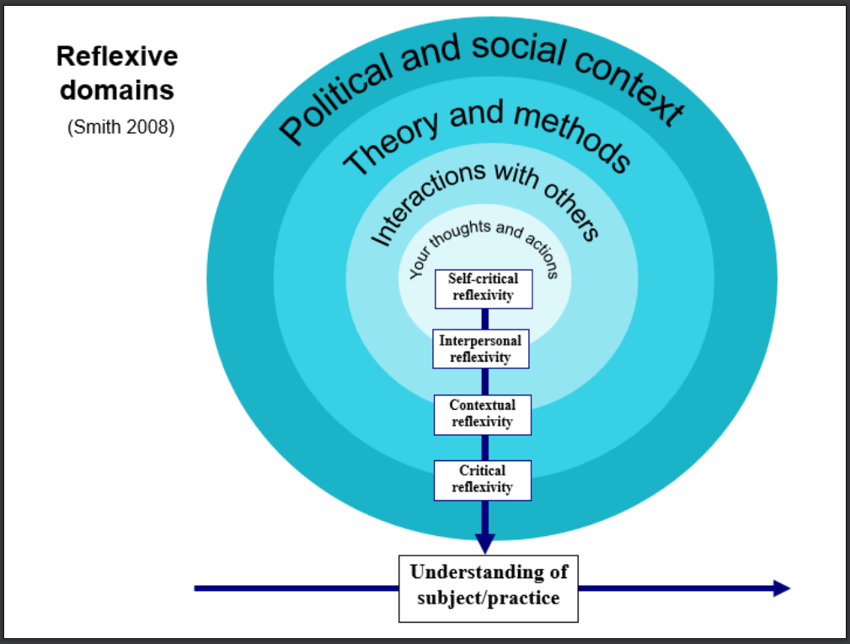
Part 1 – Why policy impact?
2008
Power, knowledge and service user voices
https://www.researchgate.net/publication/230751200_Teaching_Critical_Reflection
27,000 views
200+ citations
Who wins and who misses out?

Slide 8
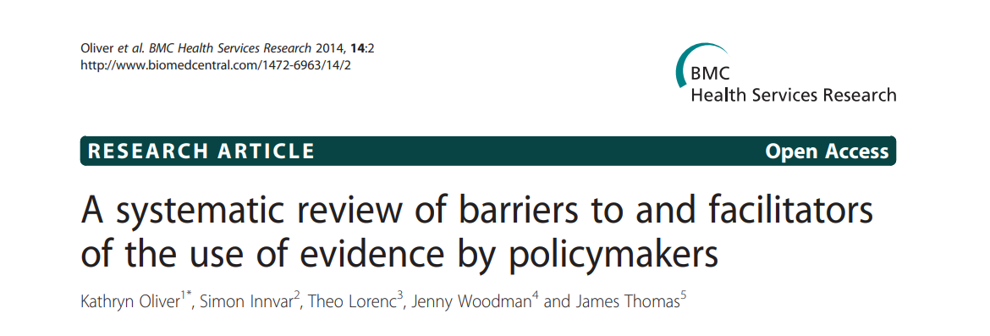
(145 studies)
Part 1 – Why policy impact?
https://doi.org/10.1186/1472-6963-14-2
2014
Timely quality evidence
Collaborations with policymakers
Relationship- and skills-building for policy impact?

Slide 9
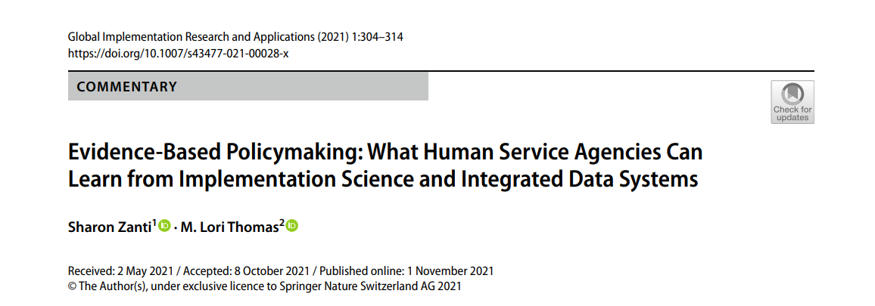
Part 1 – Why policy impact?
2021
doi: 10.1007/s43477-021-00028-x
More effective policies, less unintended consequences
Transparency and (re-build) public trust
Better understanding of policy impact and influence?

Slide 10

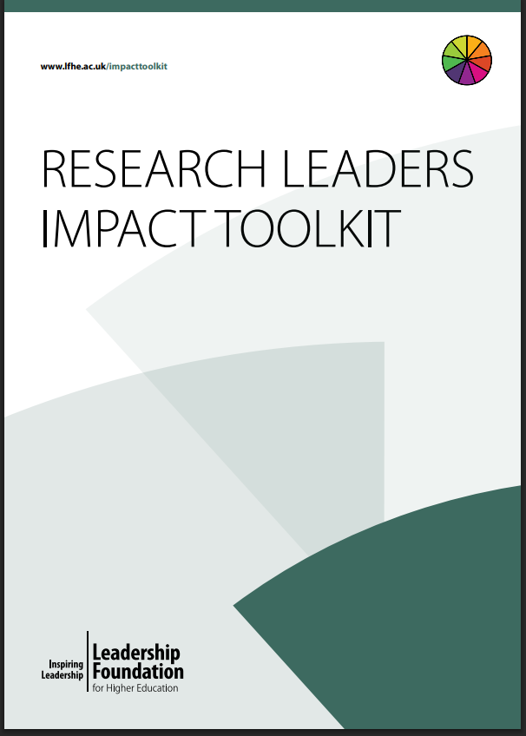
Actually – what is policy impact?
2015 - 2017
Impact case studies
Feedback loops (verbal/digital)
Testimonials
Impact tracking
Theory of Change/Logic models
Research Leader’s Impact Toolkit:
https://www.advance-he.ac.uk/knowledge-hub/research-leaders-impact-toolkit-introductory-pdf

Slide 11

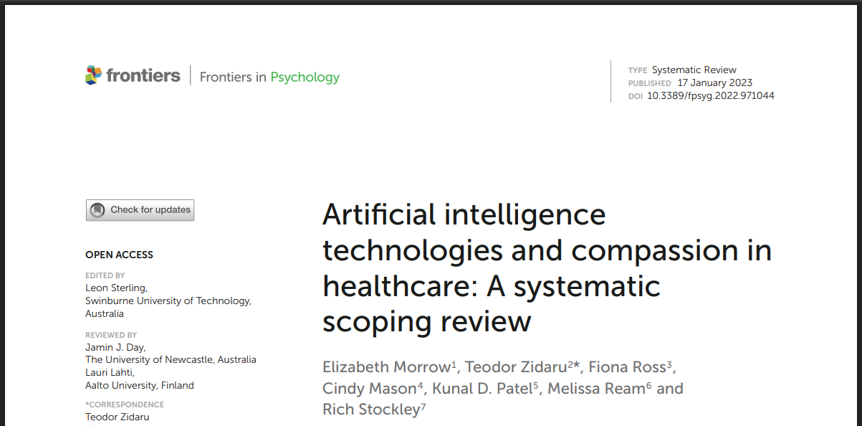
Part 1 – Why policy impact?
2022
(…20 projects later)
Publications on AI – algorithmic injustice
Growing interest in “engaged research”
NIHR Shared Commitment to Public Involvement in Health and Care Research
National Coordinating Centre for Public Engagement
https://doi.org/10.3389/fpsyg.2022.971044
229 Citations
69,8k Views
21,2k Downloads
But is research having real-world impact?

Slide 12
Part 2 –
All Ireland Institute for Hospice and Palliative Care
Aim: To gather evidence to inform an all Ireland position paper on rehabilitative palliative care
Case study 1

Slide 13
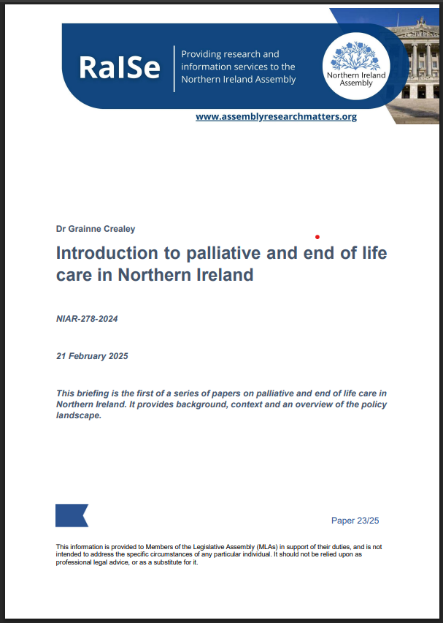
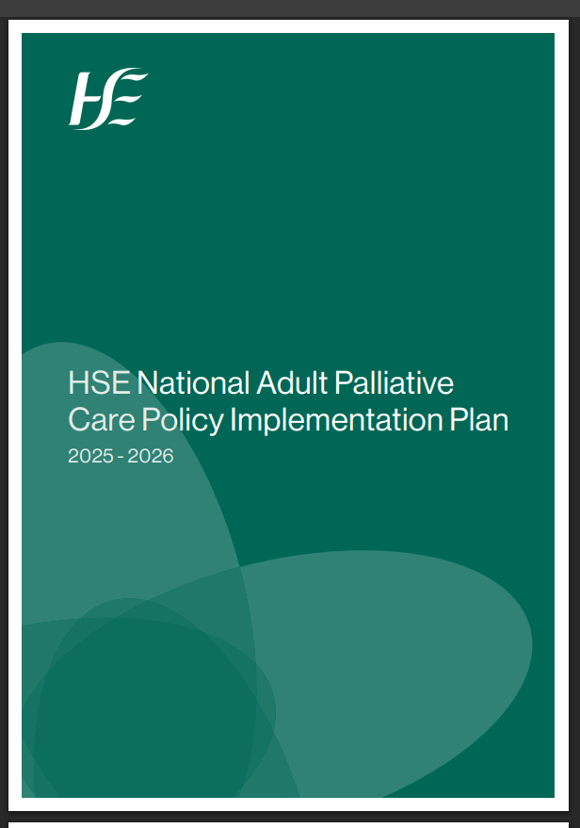
Part 2 –
Palliative care policy context 2024-
Ireland’s national strategies: DoH and HSE-led, integrated, early-access palliative care
Northern Ireland strategy: DoH and HSC focusing on coordinated end-of-life care services and regional consistency
Share common goals:
Person-centred
Emphasis on quality of life, symptom management, and holistic support
Involvement of patients and families
- Service integration and continuity
- Expanding home-based care and hospice services

Slide 14
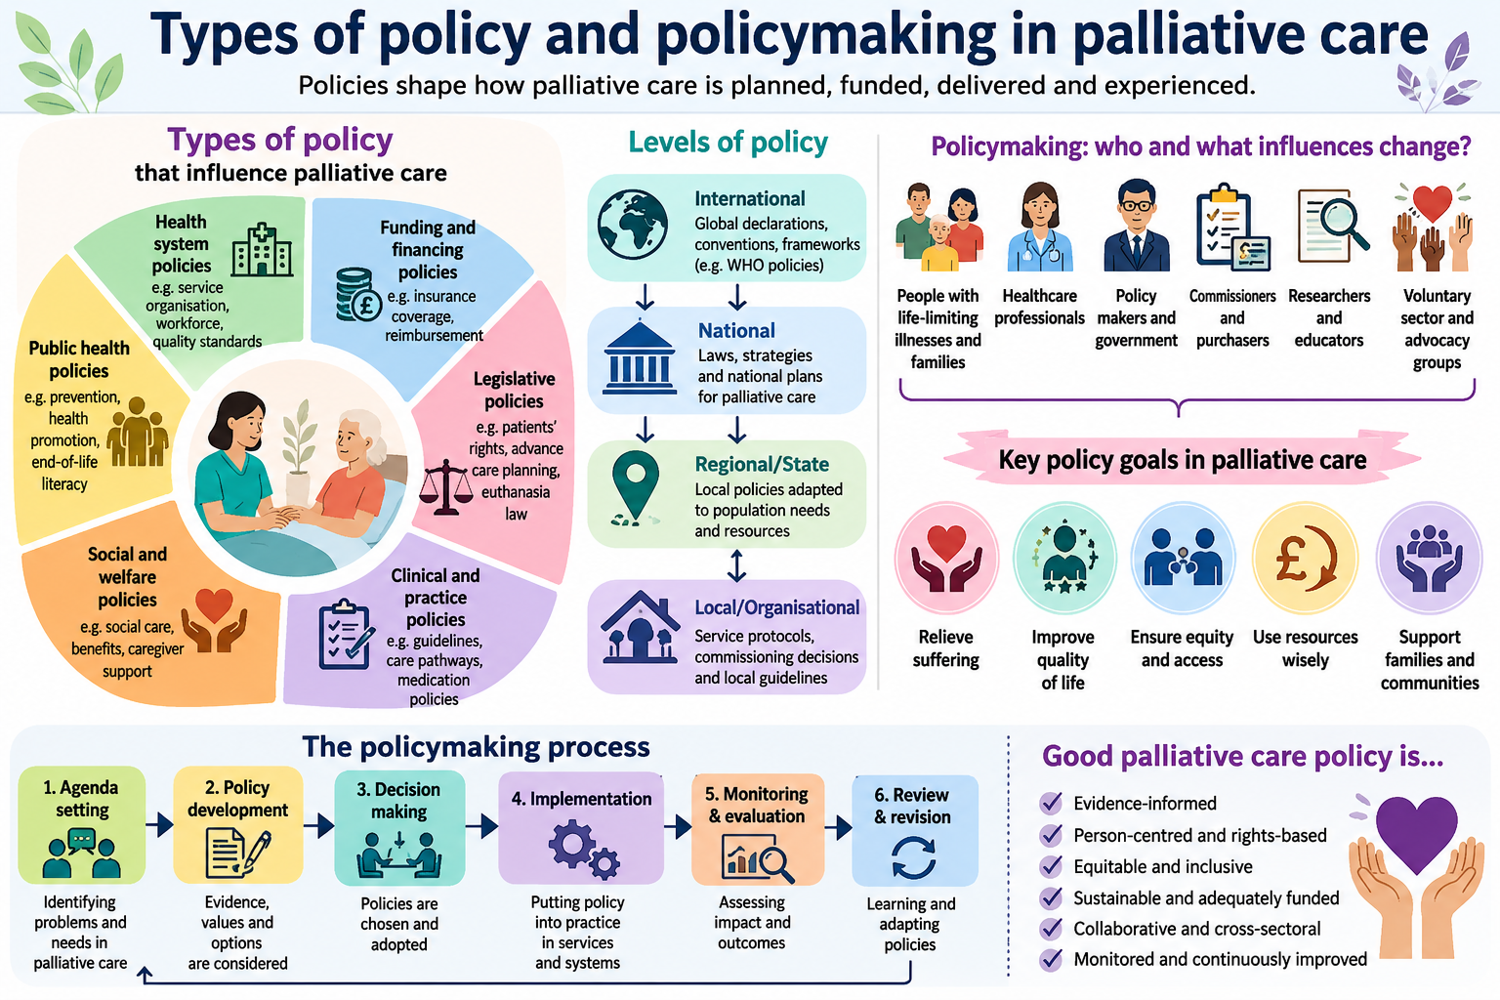

Slide 15


All Ireland Position Paper on Rehabilitative Palliative Care
Drivers for RPC
Why rehabilitative palliative care? Provides the type of care and outcomes that people want Reduces deconditioning and unplanned admissions Improves healthcare effectiveness and use of resources Supports equity and inclusion e.g., people with non-malignant disease and younger adults
National Adult Palliative Care Policy 2024, Strategic Objective 1. Right Care - 1.2 Develop, evaluate and scale models of rehabilitative palliative care provision

Slide 16
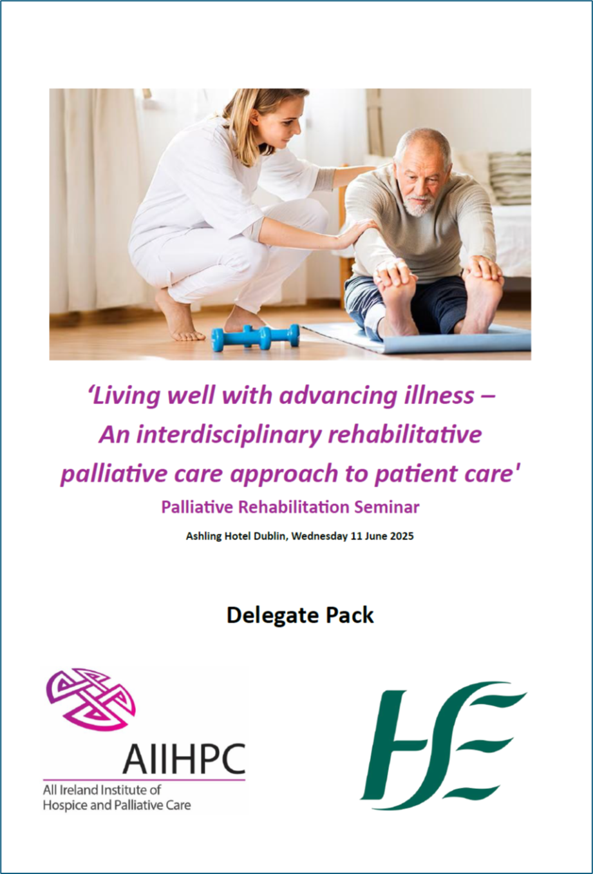
Approach
March 2025
1) Scoping review (JBI Approach) 2015-2025 (157 articles)
2) Seminar and workshop stakeholder expertise (+80 sector-wide participants)
3) Post-seminar discussion groups (6 groups, 18 people)
Development and refinement with Steering Committee members
September 2025

Slide 17
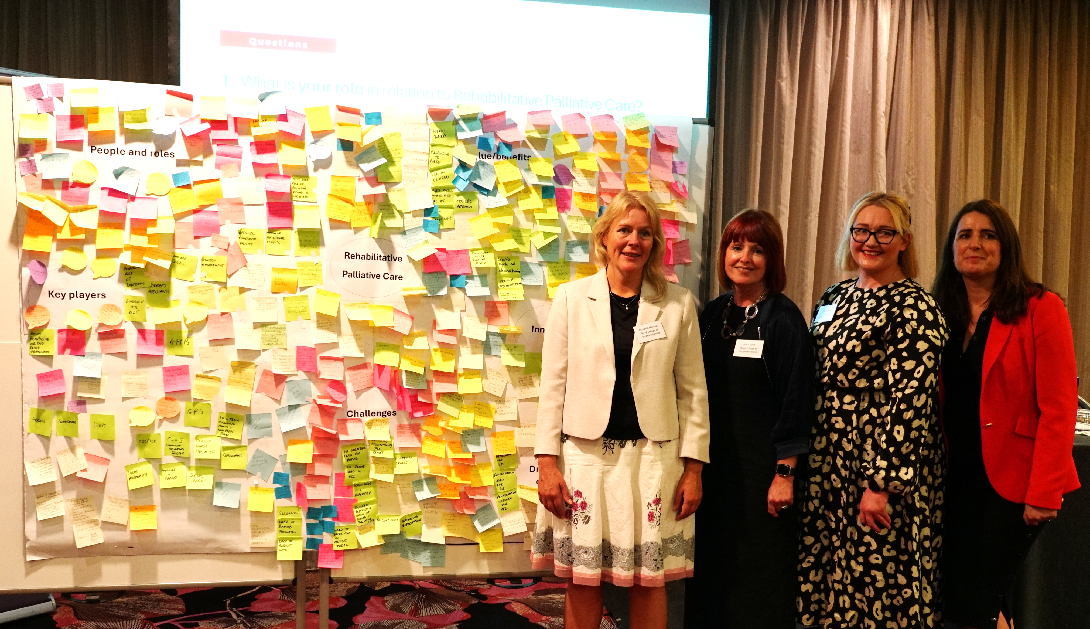


Slide 18

Nov 2025
216 pages…
… 19 pages
https://doi.org/10.25419/rcsi.30501020
https://doi.org/10.25419/rcsi.30501026

Slide 19

Case study 2

Slide 20


Slide 21

Home Support / Older Persons Hub
The overall objective of the unit is to
“Introduce a statutory scheme to support people to live in their own homes, which will provide equitable access to high-quality, regulated home care.”
Slaintecare: RIGHT CARE, RIGHT PLACE, RIGHT TIME
Notes:
Extensive and focused work is ongoing within the Department across four broad areas to make progress on the Programme of Government commitment to “introduce a statutory scheme to support people to live in their own homes, which will provide equitable access to high quality, regulated home care”.

Slide 22
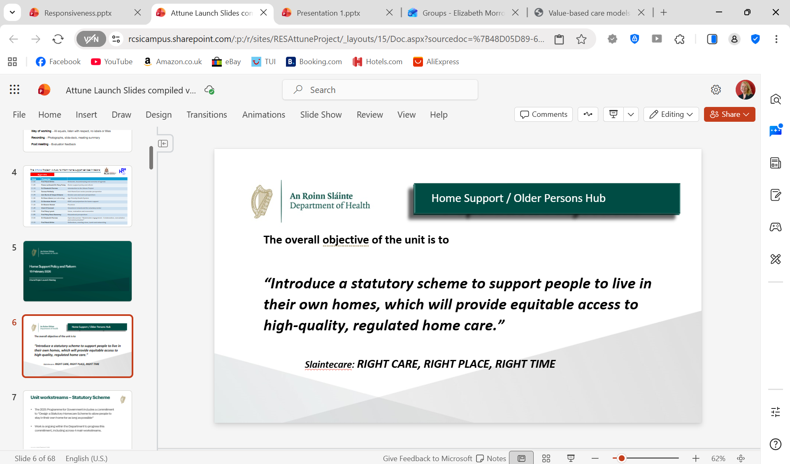
What the Attune Project aims to do
The Attune project will ensure that the voices, experiences and expectations of older adults are at the centre of research and policy development.
The research will provide valuable insights and will:
    Identify service user expectations and guide actions to further strengthen health systems.
    Provide greater insight into the home support service and how it enhances quality of life.
    Inform policy decisions regarding how best to direct resources to support people in their own communities.
    Inform the evidence base to develop the infrastructure, services and care pathways required as part of the development of the statutory home support scheme.

Slide 23





Study design
Discussion groups to link ‘lived experience’ to policy
Interviews with older adult service users and carers (family & paid)
National survey of older adults who receive home support
Dec 2025
Nov 2027

Slide 24

Service user, Carer & Advocacy panel (SCAP) perspectives March 2026
Essential need for home support:
[helps people] “stay at home where they want to be”
“golden time” [for carers]
““can be only point of contact to the outside world”
Continuity & timing of care:
“being able to build a relationship with someone, and have that consistent care, so valuable”
“[visits] chunked into blocks of time, which can be inadequate, or more geared toward the provider”
Workload burden & staff frustration:
“not having enough time for visits”
“too many visits to do”
“I find sometimes it's very frustrating.. even a simple task of walking somebody down to their gate, I need to get clearance.”
Accessing services:
“there is a very big difference.. some places get things faster”
“What's very important in [getting what you need]..[are] relationships. If you build a good relationship with the nurse, it's a great starting point”
Evolving support needs:
“if you get a care plan, does it change? I mean the needs of somebody can change completely”
“I reported that a client needs a shower chair.. I
ordered that.. end of October. .I'm still waiting. ..it's a simple shower chair and I have to wait for an OT to come out and assess”
Fear of loss of service:
“One [carer] in particular can be a bit lax about time. I don't report it because I feel if I do she'll be taken away and then [I’ll have] nobody”

Slide 25
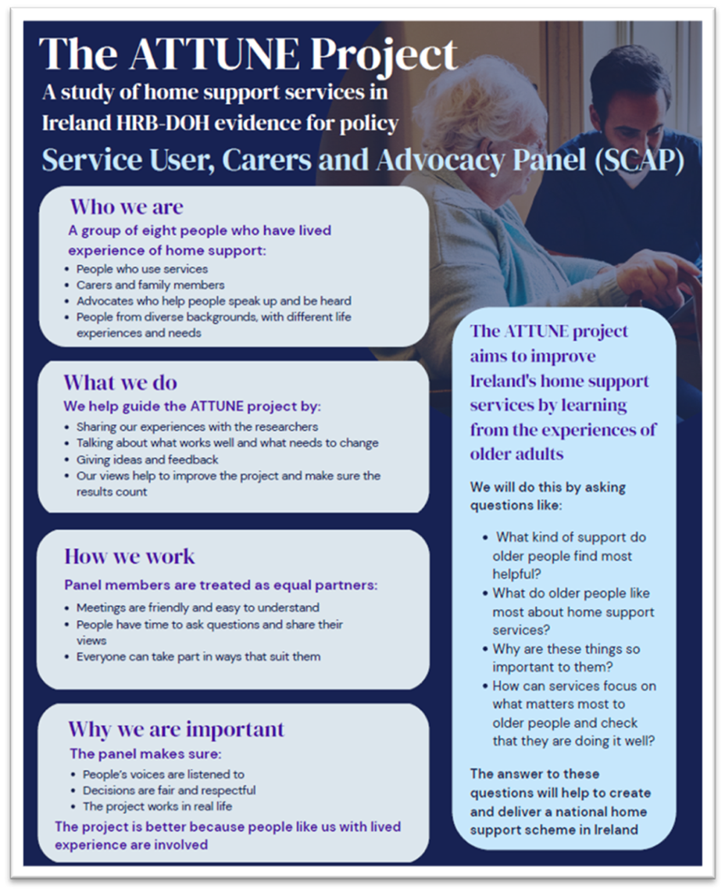

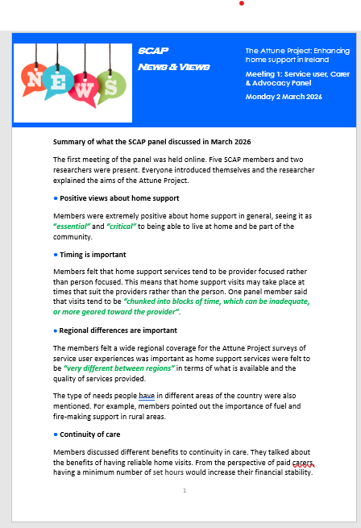
May 2026
What works:
Stakeholder engagement & PPI
Briefing papers and newsletters
Discussions
Website https://attune-project.eu/
Visuals and presentations
Service User, Carer & Advocacy Panel (SCAP)
International partners

Slide 26
What do we mean by responsiveness?
Aspects at Organisational level
Aspects at Individual level
Timely delivery
Review – evolving needs
Sufficiency of care and time (ADLs/IADLs)
Adequate staffing
Services align with needs
Continuity of care
Responsiveness
Benefits of support – direct/indirect
Informed choices
Expectations of service user – degree of support needed, flexibility
Knowledge – available supports/care plan
Effective communication
Source: The Attune Project, 2026

Slide 27
Lessons Learnt
From growth zone towards mastering (June 2026)
Getting through discomfort - prepare
Role /duty - to amplify lived experience and voices
Confidence in research methods and rigour
Mobilising intellectual capital - co-applicants and collaborators
Actively seeking feedback and acting on it

Slide 28
Practical Framework
Part 4 - Policy Analysis Framework
In development 2026:
Practical tools to analyse policy and identify gaps where research can influence and inform change

Slide 29
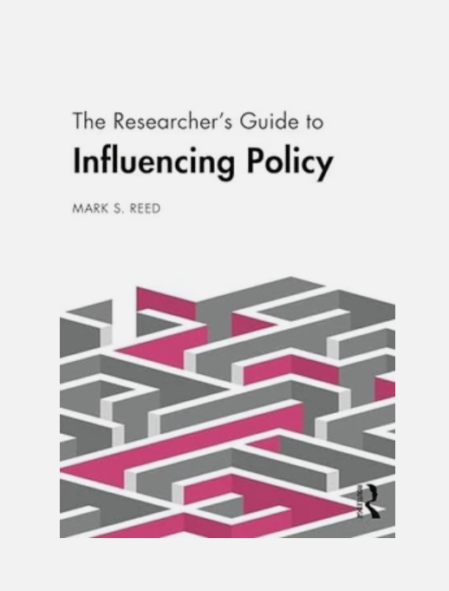
Part 4 – Practical Framework
Recommended text
Practical reflective guide, good for early career researchers
Mark Reed, The Researcher’s Guide to Influencing Policy (Routledge, 2024)

Slide 30
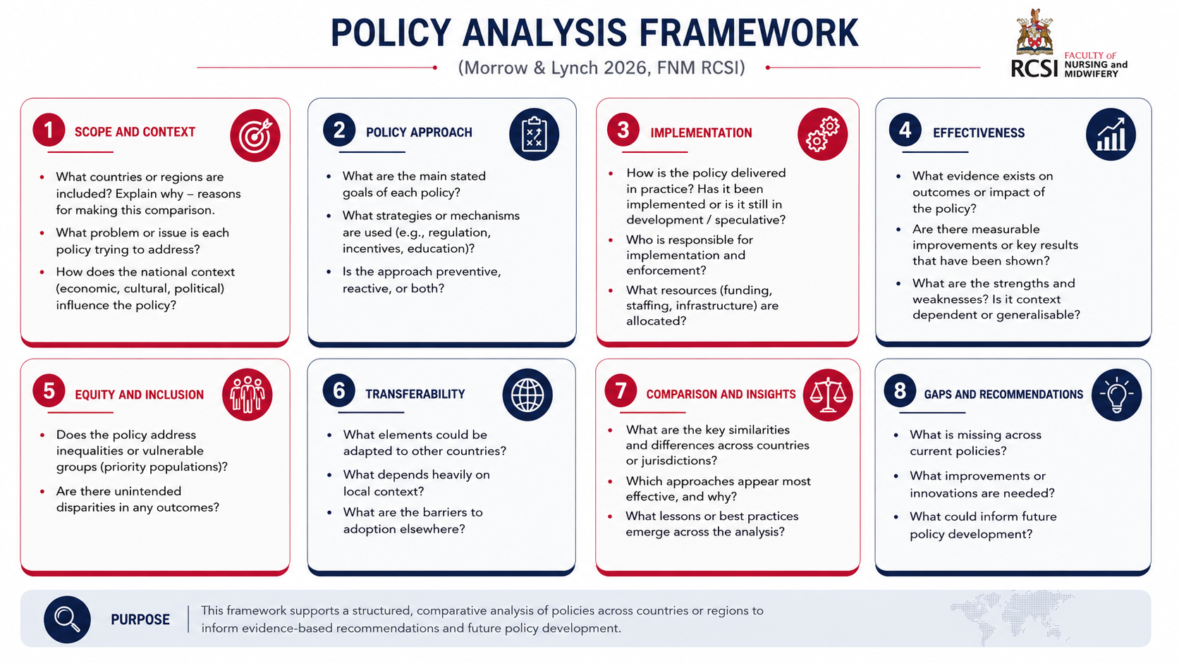

Slide 31
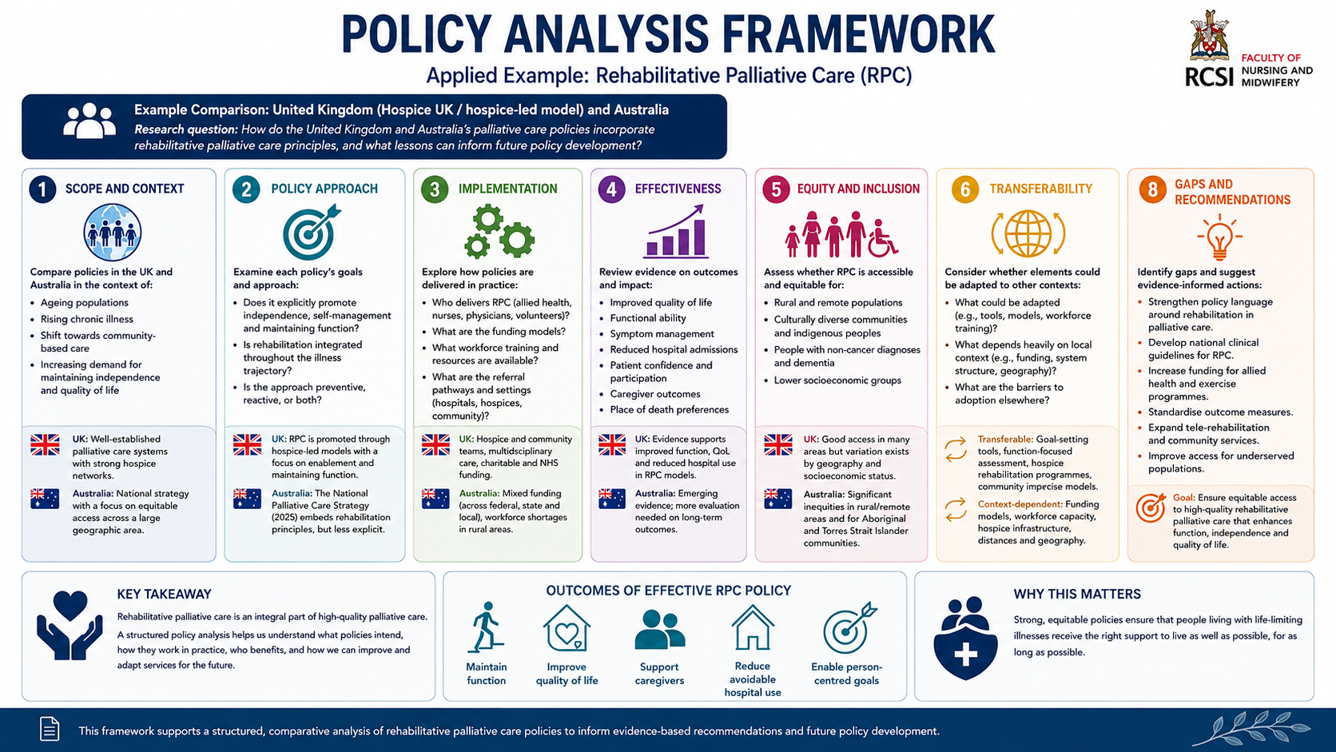

Slide 32
Conclusion
- A journey of evidence to policy reflected by a personal journey of learning and professional growth
- Not a linear or smooth process but an ongoing cycle of generating knowledge, implementing change, evaluating outcomes, and refining practice

Slide 33

LINKS
Thank you
Dr Elizabeth Morrow
Elizabethmorrow@rcsi.ie
https://www.linkedin.com/in/elizabeth-morrow-2b622714/
References:
Rehabilitative Palliative Care: Evidence to inform an all Ireland position paper https://doi.org/10.25419/rcsi.30501020
All Ireland position paper on Rehabilitative Palliative Care (Green paper) https://doi.org/10.25419/rcsi.30501026
Rehabilitative Palliative Care: Scoping Review to Inform an All-Ireland Approach to Development. Arch Palliat Care Med 7: 120. DOI: 10.29011/2689-9825.000120

Slide 34

Files will be available on
Past Events - The Palliative Hub Professional (professionalpalliativehub.com/events)
)
Thank you for your time

